Slide 1

CAPSTONE PROJECT MOVIE SPOILER DETECTION
TEAM: KANYARASHI SQUAD:
AKASH GUJE BHANU PRAKASH NOAH DAVID PRAMOD REDDY GURRALA SAI VARUN KOLLIPARA

Slide 2
Introduction:
Motivation:
Movie spoilers are a common problem for movie enthusiasts who want to enjoy a film without any prior knowledge of the plot. In this project, we propose a solution to predict the presence of spoilers in movie reviews using natural language processing techniques and blur them on any website so that it is not visible for the end users of that website
The business problem that we aim to address is the presence of movie spoilers in online reviews. Spoilers not only ruin the experience for movie-goers but can also lead to a decrease in box office sales. Moreover, websites that allow spoilers can lose traffic and revenue due to the negative impact on user experience.

Slide 3
Methodology:
Data Source:
IMDB
Data Preprocessing
Exploratory Data Analysis
Flask Integration
Deep Learning Models
Traditional Models
Cloud Deployment
Web Extension

Slide 4
Data Collection
To extract the reviews from IMDB website, we have leveraged python’s Beautiful soup package to extract reviews from "https://www.imdb.com/chart/top/"
No.of Spoilers | 6336
No.of Non Spoilers | 16534

Slide 5

Exploratory Data Analysis
Similarity score gave us an insight on how each movies are classified us spoilers and non spoilers. This also showed how some movies were missed classified as spoiler.
Reviews
Plot Synopsis
Similarity Score
Cosine similarity
Doc2Vec
No Semantic
Semantic

Slide 6
Exploratory Data Analysis - Continues
But can we consider similarity as a feature to be included in identifying a review as a spoiler or not?
To verify this we performed Hypothesis testing:
From a user point of view and from a model point of view, It is important for the model to identify non spoilers as spoilers than classifying spoiler as non spoilers.
H0 : There is no significant difference
Ha : There is a significant difference
Mann-Whitney U Test (alpha - 0.05)
Result
P-value: 0.0, hence H0 rejected
Median Doc2vec value = 30
30 represents 3rd quartile in the non spoiler dataset
Threshold = 30

Slide 7
Exploratory Data Analysis - Continues
But can we consider 30 as threshold?
To verify this we performed Hypothesis testing:
Updated Dataset size:
H0: There is no relationship
Ha: There is a relationship
Chi- squared test (alpha: 0.05)
Results
P-value = 0.0, hence H0 rejected
Spoilers data | 10216
Non Spoiler data | 12663

Slide 8
Models
Traditional Modeling:
Model Training
Model Testing
Model | Count vectorizer |  | Tfidf Vectorizer
 | Recall | FNR | Recall | FNR
Logistic Regression | 56% | 28.8% | 61% | 27.5%
SGD Classifier | 53% | 27.2% | 62% | 27%
Random Forest Classifier | 58% | 31% | 62.9% | 27.5%
Model | Count vectorizer |  | Tfidf Vectorizer
 | Recall | FNR | Recall | FNR
Logistic Regression | 60% | 31.8% | 63% | 29%
SGD Classifier | 57% | 34% | 63% | 29%
Random Forest Classifier | 58% | 33% | 65% | 28%

Slide 9
Neural Networks
After implementing the traditional model, we tried exploring deep learning neural network starting with Artificial Neural network model with three fully connected layers and 512 neurons in each layer. After performing 20 epochs the following are the results:
We also implemented LSTM:
Loss | Train Accuracy | Test Loss | Test accuracy | FNR
0.5709 | 0.7034 | 0.5854 | 0.7063 | 25%
Loss | Train Accuracy | Test Loss | Test accuracy | FNR
0.3742 | 0.8373 | 0.6962 | 0.6732 | 28%
The lstm model was completely overfitting. The DNN model has given a good result and the model is also stable hence we have decided to go ahead with this model's implementation for our final output as well.

Slide 10

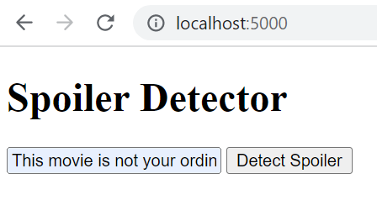
Flask Integration
Flask is a lightweight web framework that can be used to deploy machine learning models as web services. With Flask, you can create a RESTful API that can receive input data, run it through your ML model, and return the results as output.
This movie is not your ordinary Hollywood flick. It has a great and deep message. This movie has a foundation and just kept on being built on from their and that foundation is hope.
RNN Model from Azure / Docker
User Movie Review
SPOILER
NOT SPOILER

Slide 11

Web - Extension
User friendly interface and easy to load on popular browsers
Easy and fast to detect spoilers and hides the reviews from reading
Real-Time Prediction
Preview of the Chrome Extension

Slide 12
Microsoft Azure Hosting
Creating VM and Container Repository Service
Using WSL to connect with VM
Loading the Repository into the VM
Creating Docker Images for the Flask Application
Using the Public IP / DNS for connecting to the Model on Server

Slide 13
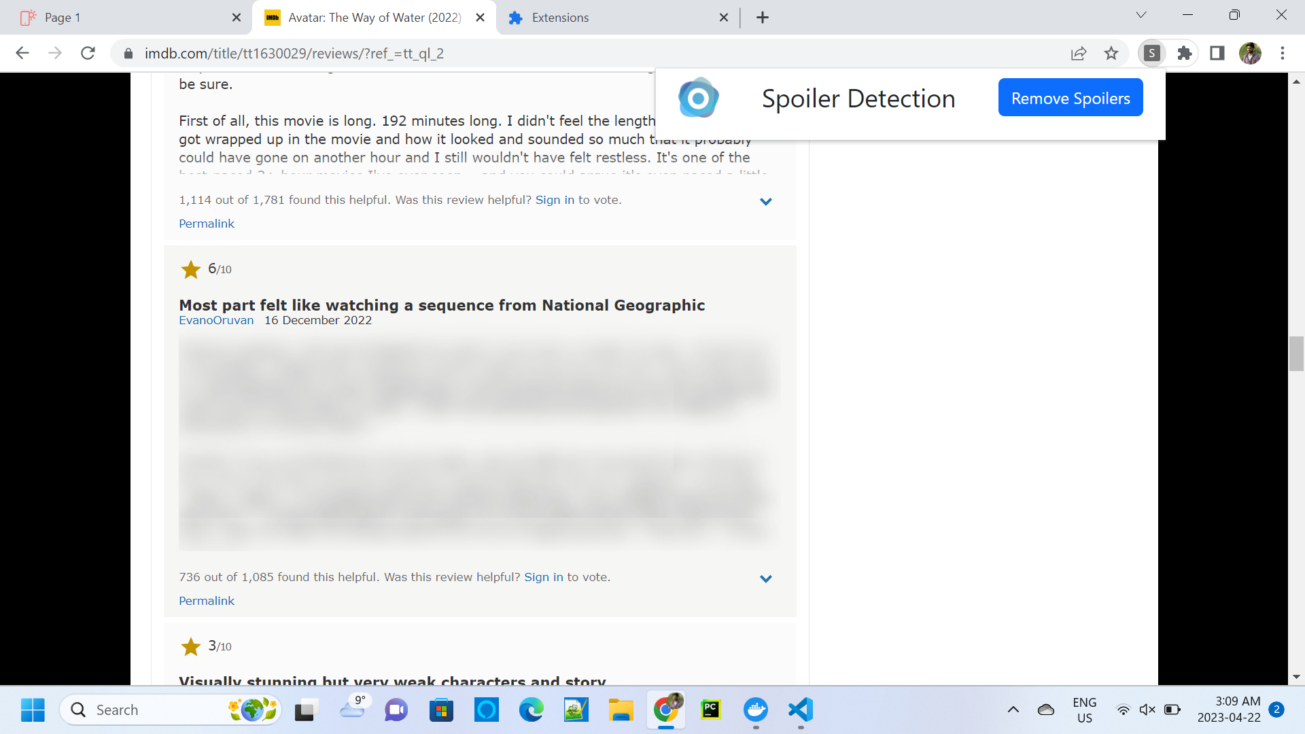
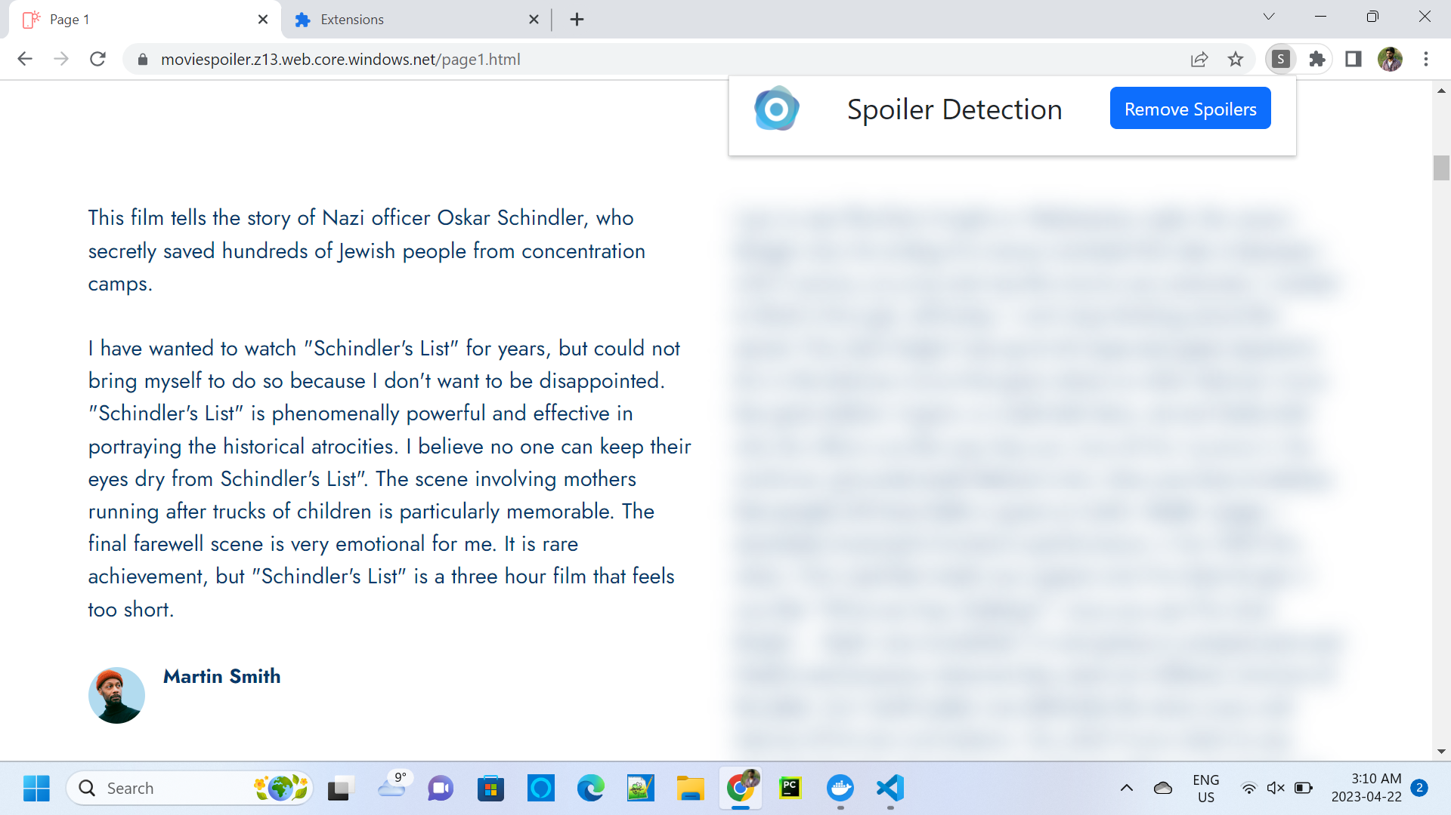
Results
Sample Static Website Comments
IMDB Website User Reviews

Slide 14
Conclusion and Future Developments
To conclude, we have created a google chrome web extension that can identify and blur the spoilers from movie review websites. We have built our own Neural Network models trained and tested with the review data we scrapped from multiple online resources.
Furthermore, we have done Flask integration, Docker Deployment, and Azure Cloud Hosting with the model. We are limited to working on the Chrome browser and the IMDB website for this research.
Future Developments:
Collaborate with movie studios
Expand to other platforms
Integration with social media platforms

Slide 15

THANK YOU

